Slide 1

PowerShell User Group
Southampton 28/01/2020
@PSSouthampton

Slide 2
agenda!
7.00pm - Arrival
7.15pm - Welcome / User Group Introduction - @jonathanmedd
7.30pm - Working with different types of data in PowerShell - Jonathan Medd
8.15pm - Break / Pizza / Refreshments
8.45pm – Working with different types of data in PowerShell - Jonathan Medd
9.30pm - Wrap up / Close

Slide 3
Welcome and Practicalities
Fire exits
Respect our hosts
Deposit and Public Liability Insurance is on me
THANK YOU!

Slide 4
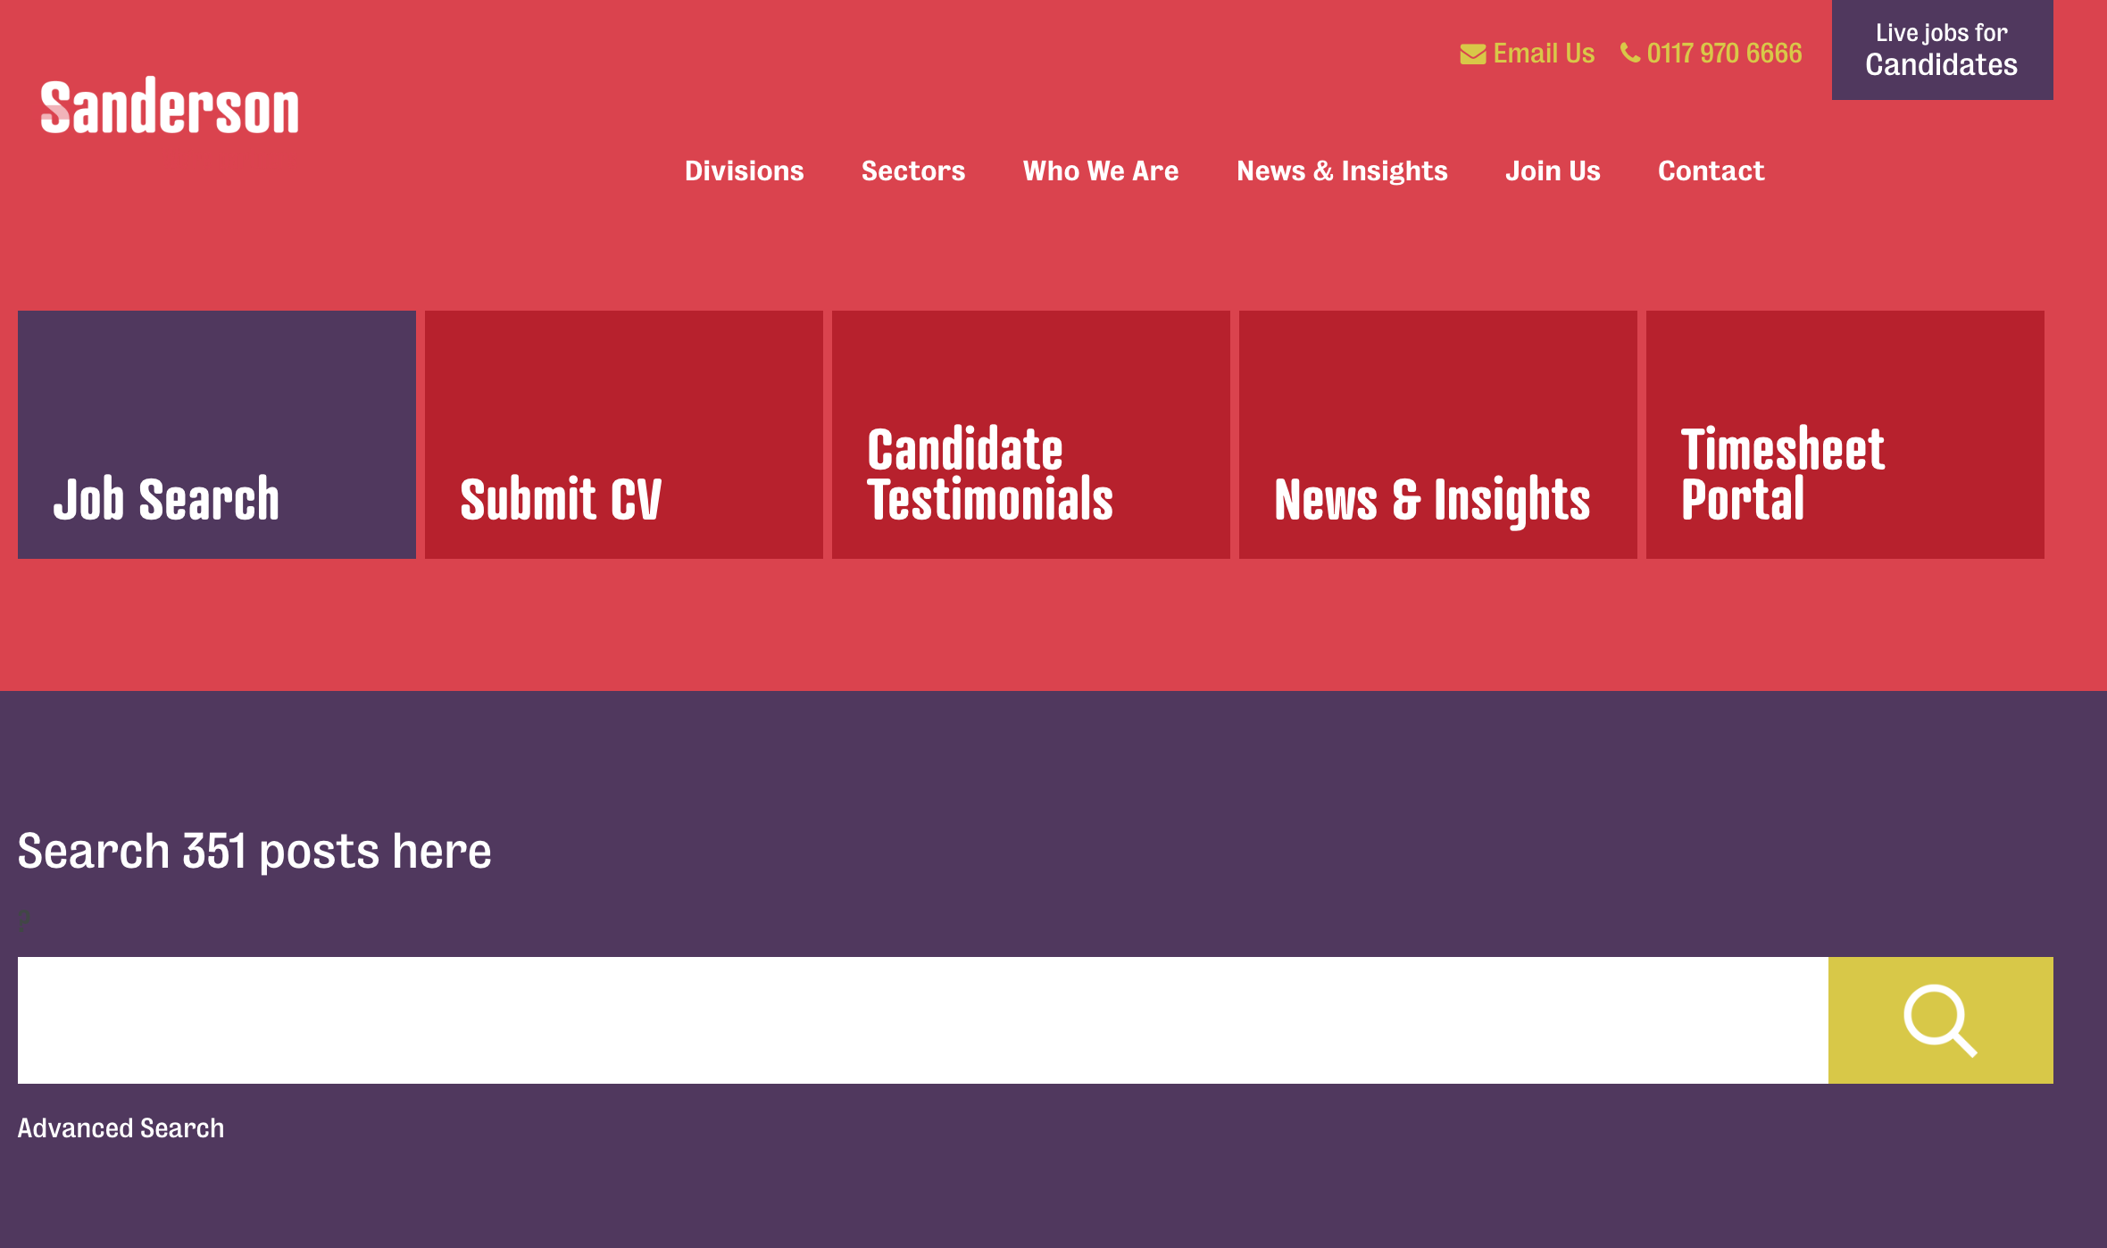
SPONSOR

Slide 5
SANDERSON – Current Vacancies
Current vacancies with:
Kingfisher
Carnival
Old Mutual
Vitality
For more info, chat to Hannah during the break or
Hannah.Waddington@sandersonplc.com

Slide 6
User Group
Aim to meet roughly every 1 – 2 months
In 2019 we met Jan – Mar, May – Jun, Sep - Nov
Tue Jan 28th – Jonathan Medd: Data Types in PowerShell
Tue Feb 25th - Will Tomlinson: An Introduction to Terraform
Tue Mar 24th – Brett Miller: GitOps and Automating Your Incident Management Process

Slide 7
Want to present?

Slide 8
We need!
Speakers
Some lined up, discussions ongoing
Topic ideas – we need to know what you want to hear about
Leave your session volunteering details on the cards

Slide 9

Communication
Meetup.com - https://www.meetup.com/PowerShell-Southampton
Twitter - https://twitter.com/PSSouthampton
Slides and content will appear here: https://github.com/powershellorguk/SouthCoast

Slide 10
RSVP Please

Slide 11
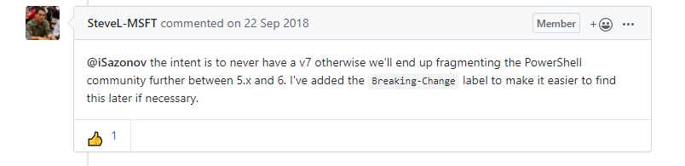
PowerSHELL News
PowerShell 7 is imminent
Currently in RC2: https://github.com/PowerShell/PowerShell/releases/tag/v7.0.0-rc.2
Notes:
https://github.com/PowerShell/PowerShell/issues/3302

Slide 12
Hurry up and move on!

